Slide 1
Filling the Land Conversion Gap with Machine Learning
Byron Allen
Data Science Student at General Assembly
22 November 2016

Slide 2
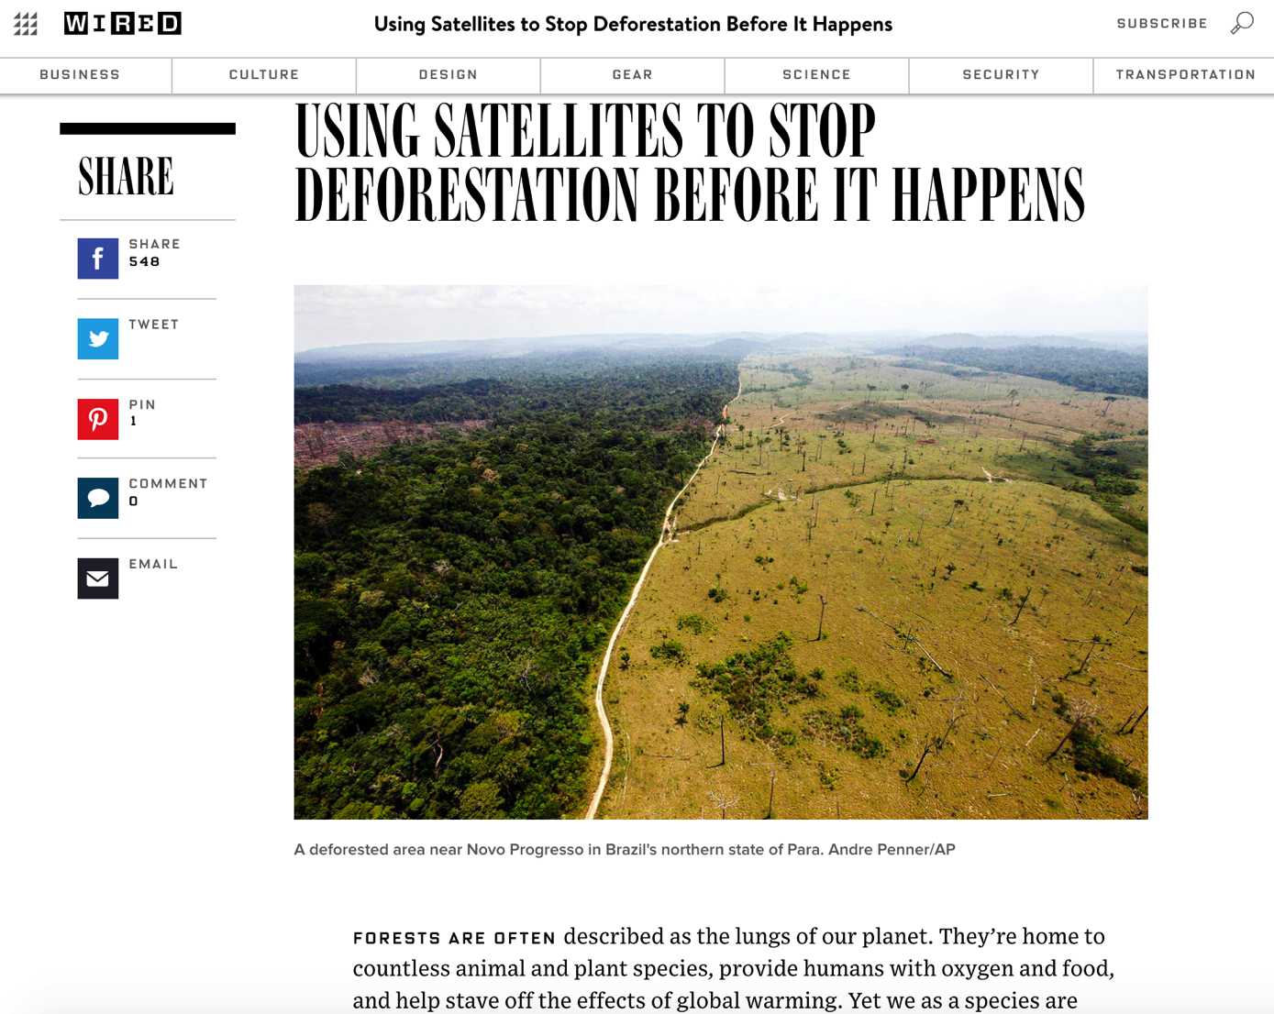
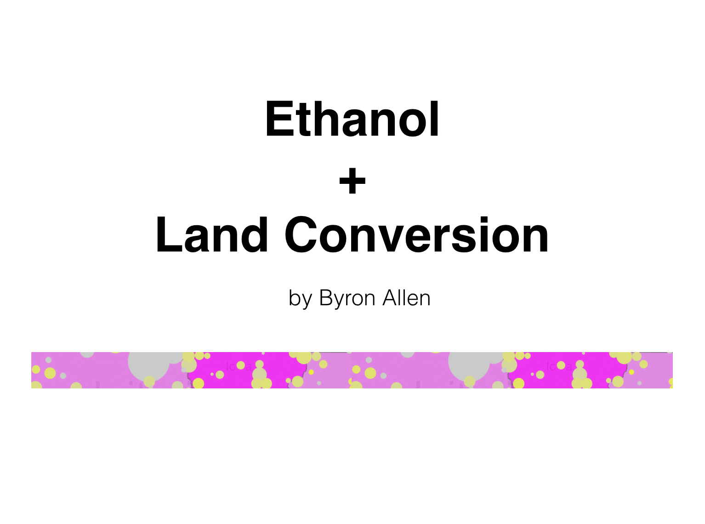
Lack of Land Conversion Data
https://www.wired.com/2015/04/using-smart-satellites-to-monitor-deforestation-from-space/
PDF link
Video Presentation link​
​Tableau Dashboard link​

Slide 3
How do we fill the gap?

Slide 4
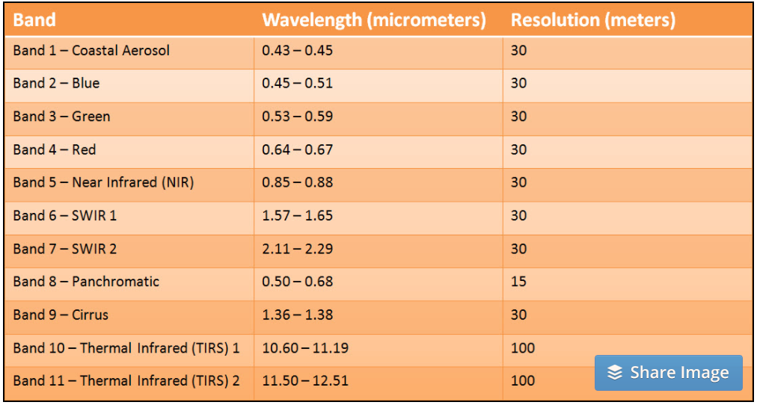
Satellite Images (Landsat 8 EVI & RAW)
http://www.harrisgeospatial.com/Home/NewsUpdates/TabId/170/ArtMID/735/ArticleID/14305/The-Many-Band-Combinations-of-Landsat-8.aspx

Slide 5
Workflow
Satellite Images
Agriculture Mask &
Vegetation-Bare Earth Array
Unsupervised Method
to Classify Land Cover
Train & Apply
Supervised Method
Consolidate Labels
Apply Ag Mask

Slide 6
Assumptions & Limitations
Geospatial sits outside the scope of GA
Clouds were avoided as much as possible
Importance placed on the workflow overall
Some models still running as of today
Need for mixed land type to train on
Data comes from composite images ranges from 2013 – 2015

Slide 7
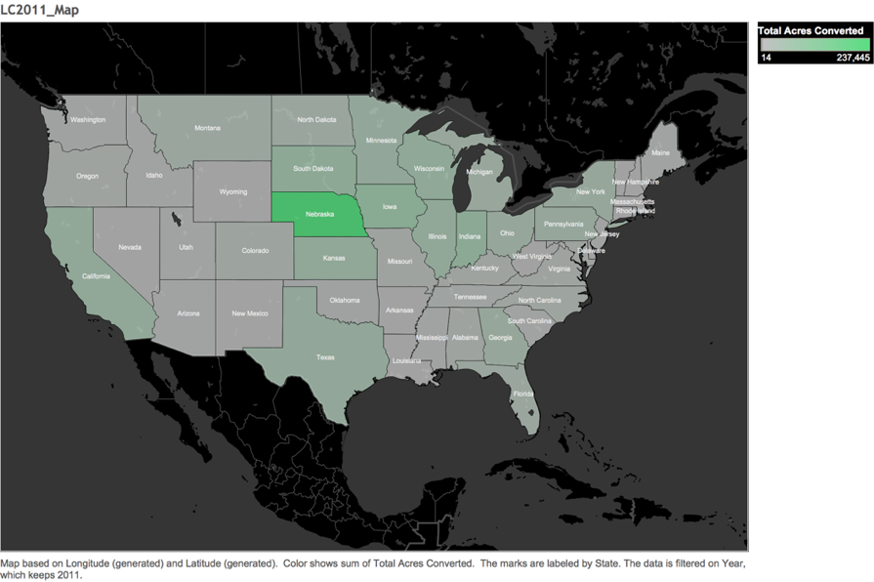
Nebraska had the Greatest LC in 2011

Slide 8
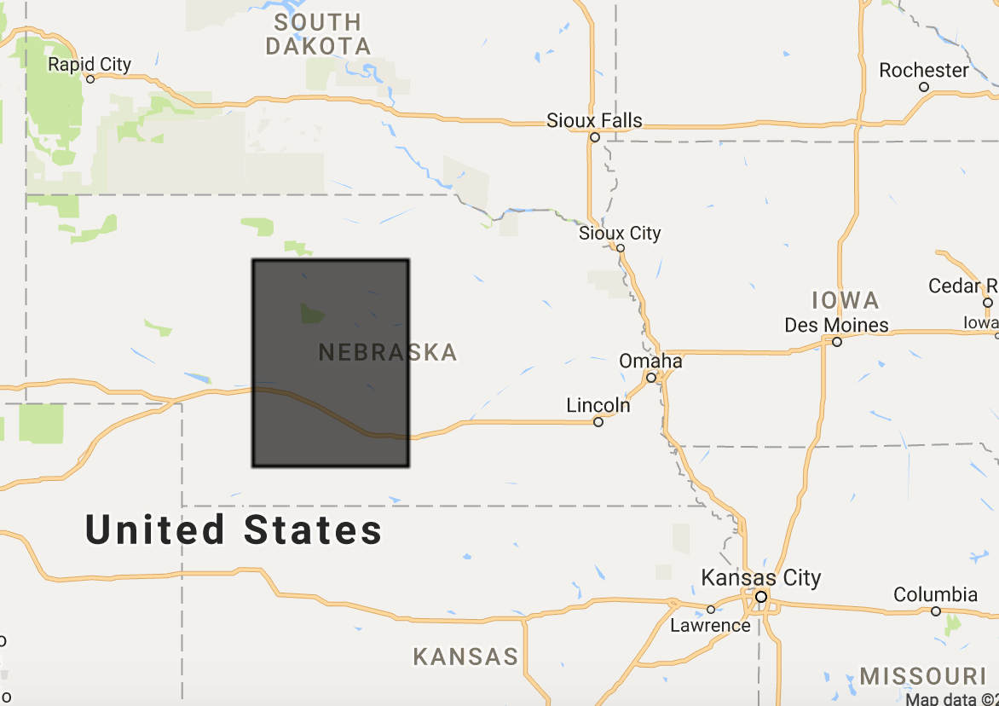
Shape of Data | A Strong Dataset to Build On
GTiff file downloaded from Google Earth Engine
Middle of Nebraska, U.S.
Resolution: 30m/pixel
Height: 7439
Width: 7422
Pixel Count: 55,212,258
Over 50,000km² of Nebraska’s total area 200,360km²
For reference, VIC is 237,629 km²

Slide 9
Bimodal Distribution to Create Ag Mask

Slide 10
Create Optimal Training Area
(Vegetation Array = (band_6 + band_5 + band_2) / 3)
-
(Bare Earth Array = (band_6 + band_3 + band_2) / 3)

Slide 11
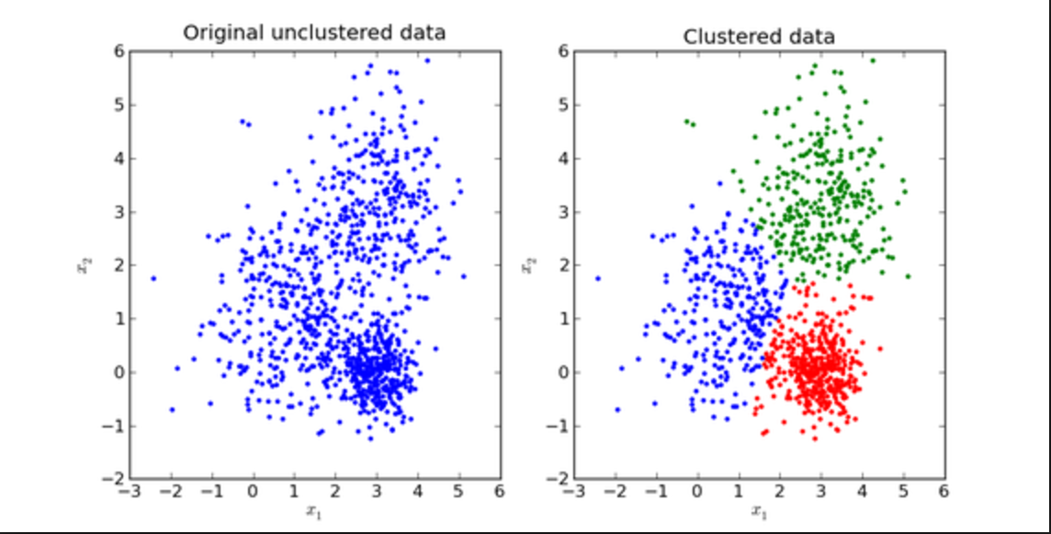
Unsupervised Model Selection
Key in defining underlying features of unlabeled data
KMeans
Agglomerative Clustering
Affinity Propagation
KMeans Example:

Slide 12
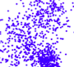
KMeans (k=30) Centroid-based Labels
A
Pixel
c
D
C
B

Slide 13
Apply Ag Mask and Consolidate Labels

Slide 14
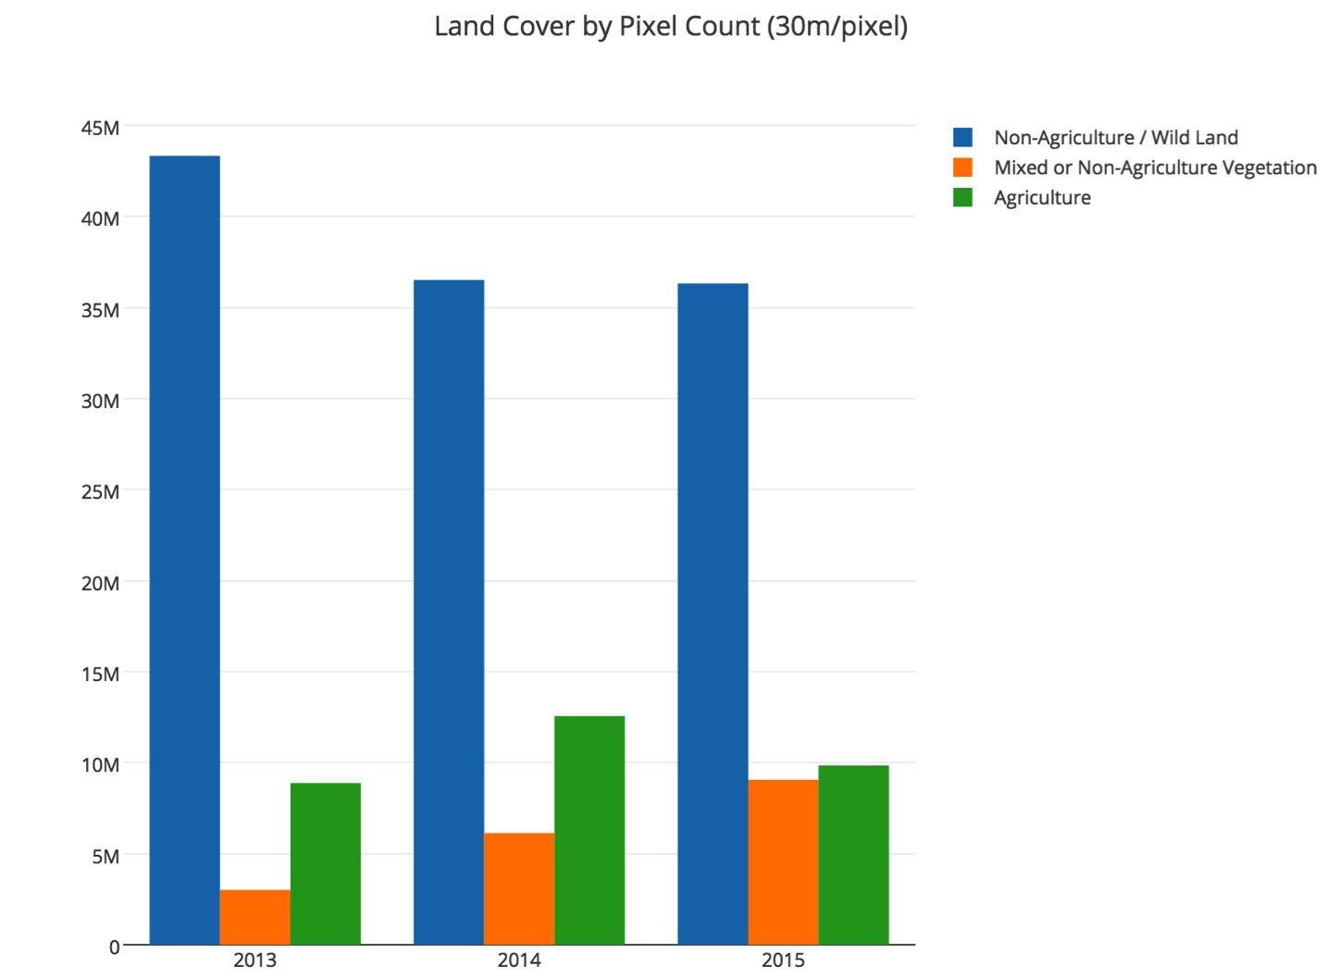
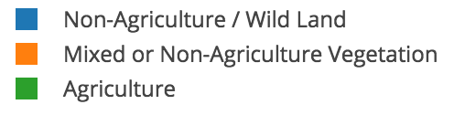
Indicates Possible Land Conversion

Slide 15
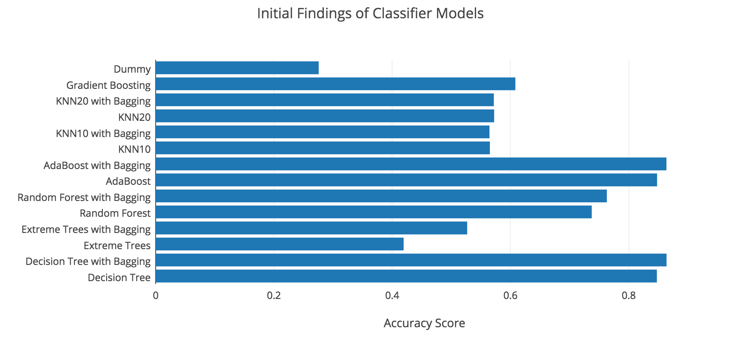
Supervised Results
Initial EDA

Slide 16
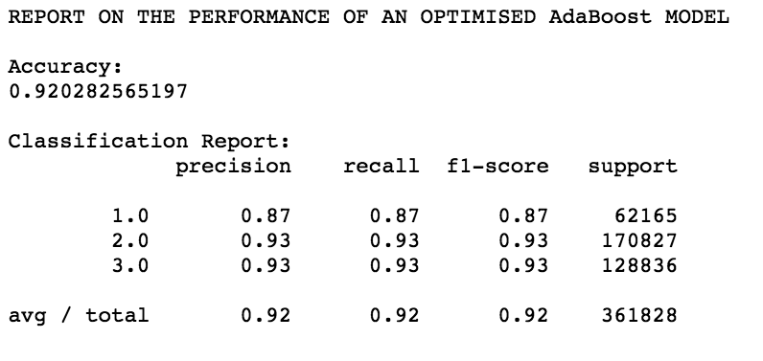
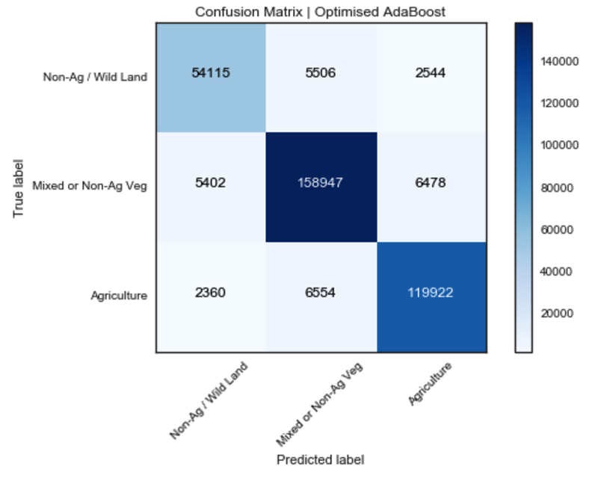
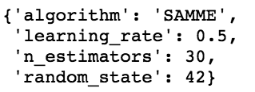
AdaBoost + Decision Tree 92% Acc.
Initial EDA

Slide 17
Recommendations/Next Steps
Include final supervised results
Improve ag masks
Fine-tune the unsupervised method (e.g. mixed vegetation label)
Sort out requirements to test hierarchical algorithms
PCA across all bands
Test a new 12-month workflow idea

Slide 18
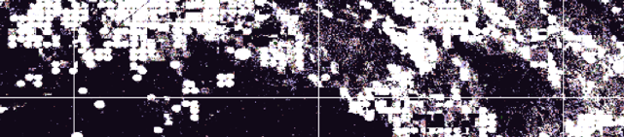
Q&A
byron.a.allen@gmail.com

Slide 19
THANKS

Slide 20
APPENDIX

Slide 21
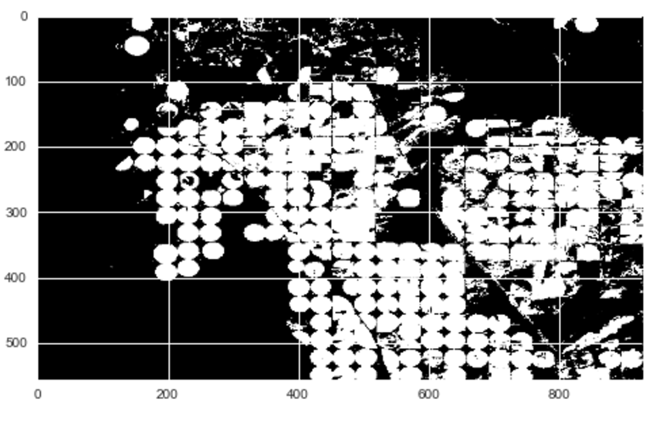
Agriculture Mask Example

Slide 22
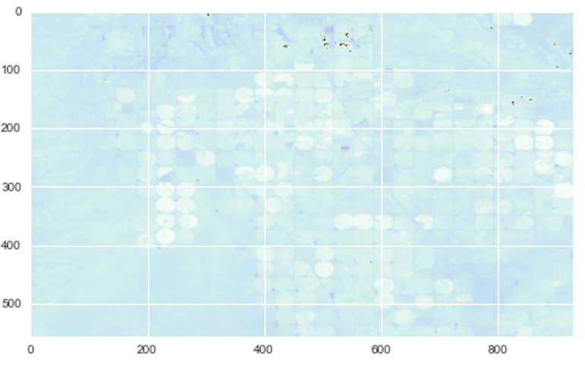
Vegetation-Bare Earth Array Example

Slide 23
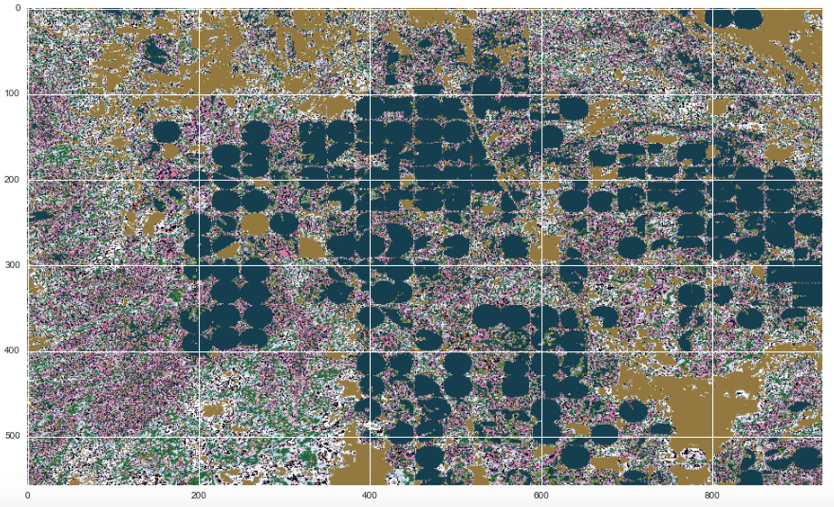
KMeans Centroid-based Labels Example

Slide 24
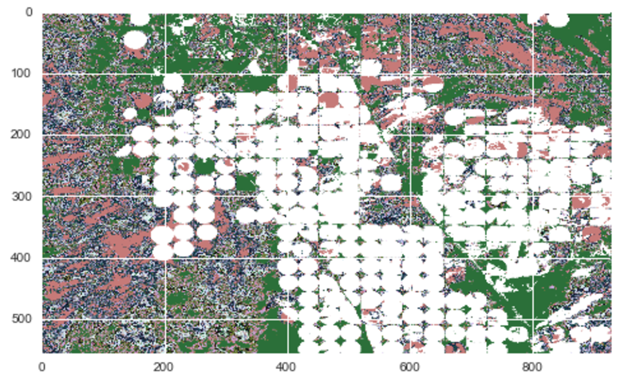
Applied Agriculture Mask Example

Slide 25
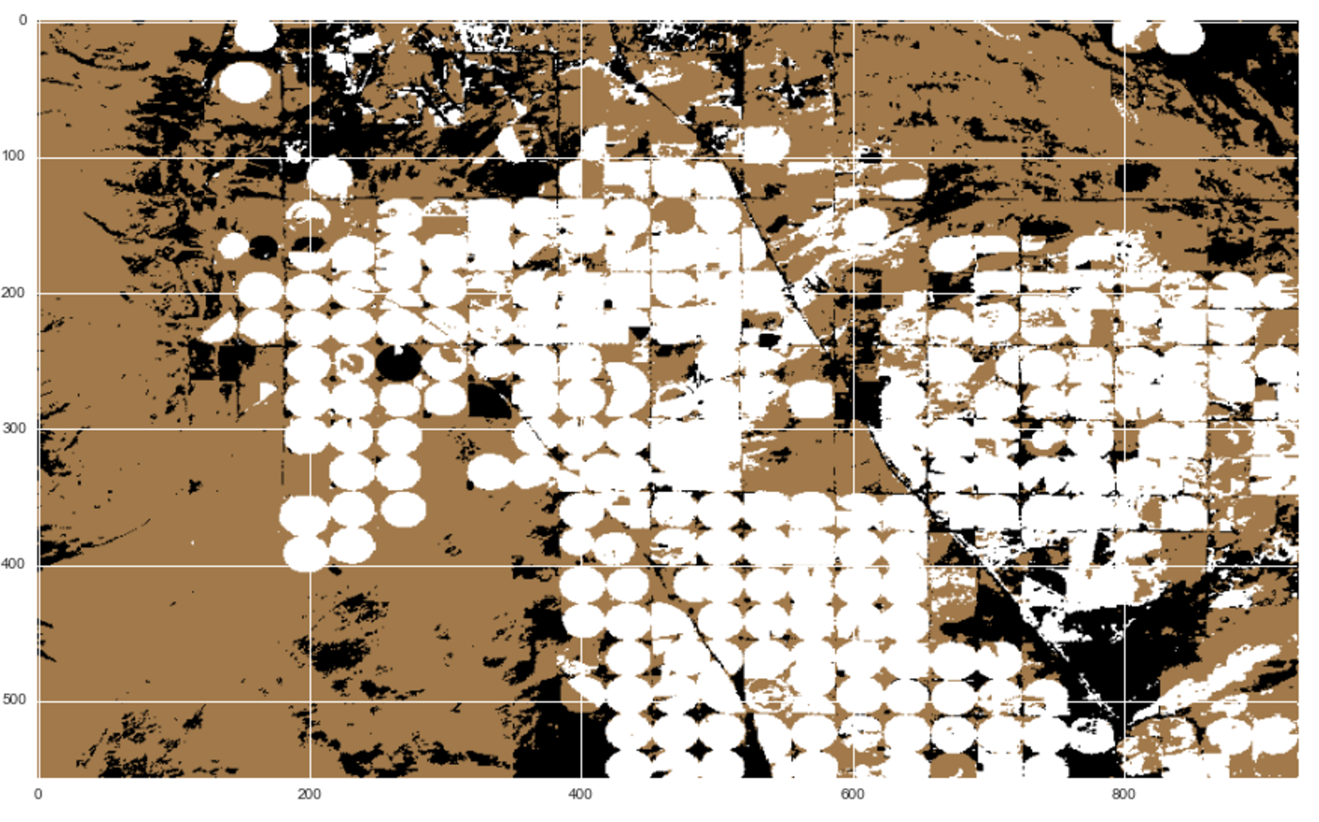
Consolidated Labels Example

Slide 26
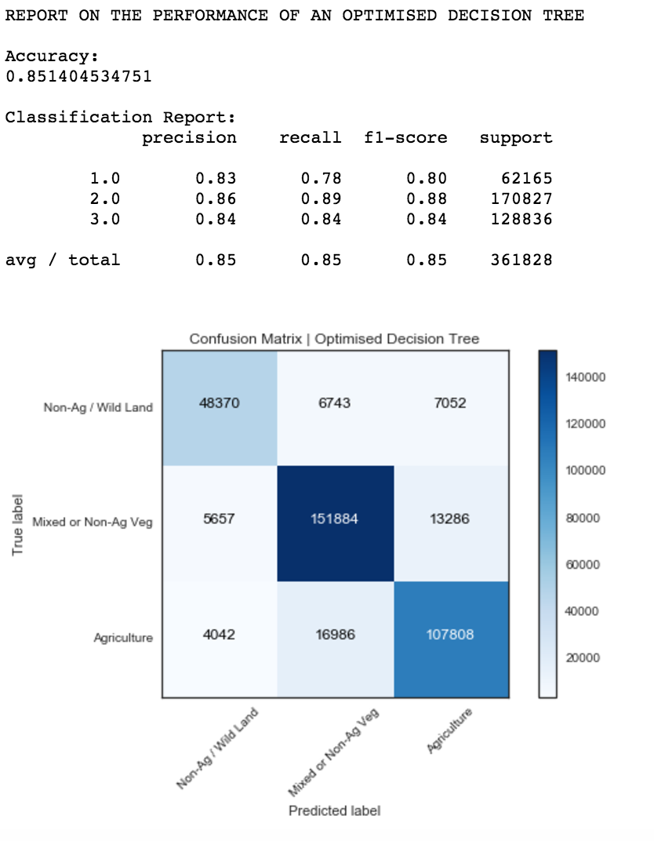
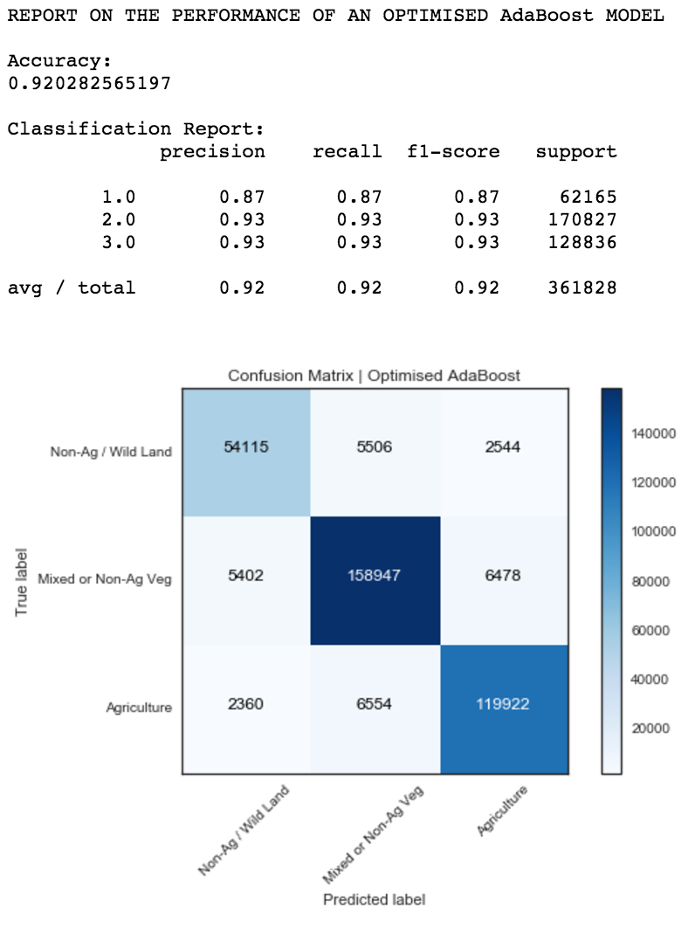
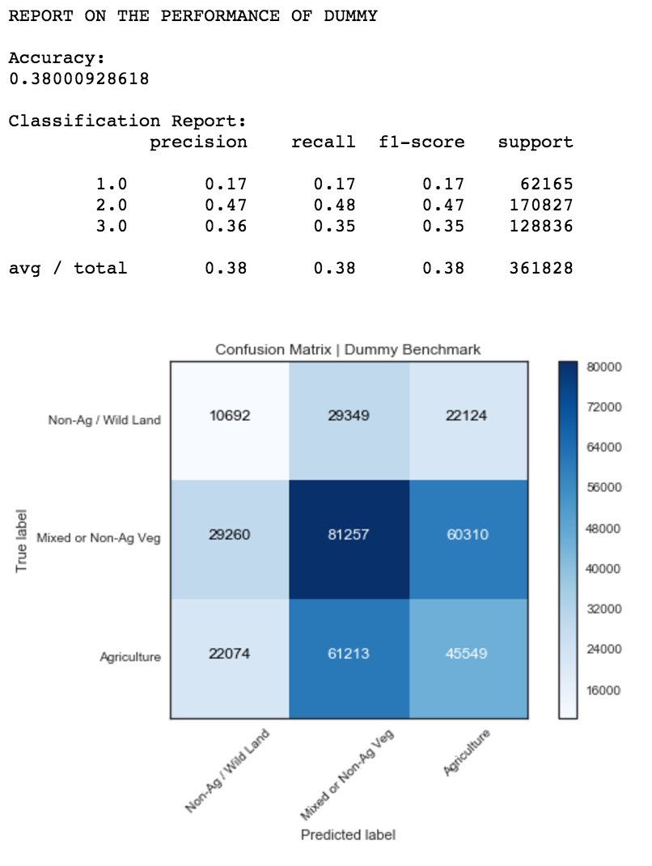
GridsearchCV Results (Best Supervised Models + Dummy)
Initial EDA

Slide 27
Libraries & Utilities Used
Python:
Fiona (a GIS lib)
Rasterio (a GIS lib)
GeoPandas (a GIS lib)
Pandas
Numpy
Matplotlib
Seaborn
Datetime
Google Earth Engine:
Javascript base
Landsat 8 32-day EVI Raster Images
Landsat 8 32-day RAW Raster Images
My own functions:
ExploreRasterImage
CreateMaskArray
StoreBandsasArrays
KMeansCentroidBasedLabeling
ClassifierAccuracyScore

Slide 28
LC-related Articles & Papers
https://www.nwf.org/News-and-Magazines/Media-Center/News-by-Topic/Wildlife/2013/9-18-13-USDA-Data-Grasslands-Forests-Being-Converted-to-Cropland-at-Alarming-Rates.aspx
https://www.fsa.usda.gov/FSA/webapp?area=newsroom&subject
=landing&topic=foi-er-fri-dtc
http://nationalaglawcenter.org/wp-content/uploads/assets/crs/RL33950.pdf
http://www.oecd.org/tad/sustainable-agriculture/44807867.pdf

Slide 29
My Previous Project on Land Conversion
PDF link
Video Presentation link​
​Tableau Dashboard link​

